Slide 1
MOVIE RECOMMENDATION SYSTEM
RNS INSTITUTE OF TECHNOLOGY
BENGALURU - 98
DEPARTMENT OF COMPUTER SCIENCE & ENGINEERING
Presentation on Internship
PRESENTED BY:
1RN19CS011 AKSHATHA K
1RN19CS103 PRIYANKA B A

Slide 2
AGENDA
Abstract
About the Company
Introduction
Literature Survey
Requirements
System Design
Detailed Design
Implementation
Results
Conclusion and Future Enhancements
References

Slide 3
ABSTRACT
We've always wanted recommendations to help us make the best decision possible.
Our large selection of possibilities is filtered by recommendations, which helps us reduce down to our ultimate choice.
A recommender system attempts to anticipate or filter preferences based on the user's preferences.
Movies, music, news, books, research articles, search queries, social tags, and products in general all use recommender systems.
Our movie recommendation algorithm suggests a movie to the user based on a wide range of options based on his first pick of a film.

Slide 4
ABOUT THE COMPANY
NASTECH – New Age Solutions & Technologies
NASTECH is formed with the purpose of bridging the gap between Academia and Industry.
Nastech is one of the leading Global Certification and Training service providers for technical and management programs for educational institutions.
They collaborate with educational institutes to understand their requirements and form a strategy in consultation with all stakeholders to fulfill those by skilling , reskilling and upskilling the students and faculties on new age skills and technologies.
Industry and project oriented student training programs.
Certification programs mapped to Global Certification Exams from Microsoft/EC- Council/Google/AWS/ Adobe).

Slide 5
INTRODUCTION
Our movie recommendation algorithm suggests a movie to the user from a large number of options depending on his first choice of a film.
The proposed system employs Python and machine learning methods to offer movies to the user depending on their choices or interests.
The recommendation algorithm suggests movies depending on the user's first choice, assisting the user in making an informed and quick decision.
The model doesn't need any data about other users, since the recommendations are specific to this user. This makes it easier to scale to a large number of users. The model can capture the specific interests of a user, and can recommend niche items that very few other users are interested in.

Slide 6
LITERATURE SURVEY
Recommender Systems (RSs) is a new study subject that has exploded in popularity. Great advancements in internet technology and e-commerce have also fueled increased interest in this research issue. For e-commerce, RSs have numerous advantages. There are three ways that RSs can improve an e-commerce system: by assisting first-time online shoppers, cross-selling products, and increasing consumer loyalty.
When Amazon debuted its Collaborative Filtering (CF) approach at the end of the 1990s, it successfully increased their sales, causing an explosion of research in RSs. As a result of Amazon's success, other online firms began to use RSs on their websites. Amazon owns a United States Patent for its CF technique.
The RS field can be regarded a subset of information filtering because the main purpose of an RS is to locate preferred information and exclude information that a user dislikes. Following the exploration of a user's preferences from historical data, machine learning algorithms are used to evaluate the data and provide a ranked list of recommended items based on the user's preferences.
The concept of using computers to select the best product for a user has existed since the dawn of computing. The first application of the RS concept arrived in 1979, in the form of Grundy, a computer-based librarian who recommended books to the user. This was followed by the release of Tapestry, the first commercial RS, in the early 1990s.
In the early 1990s, GroupLens, a research lab at the University of Minnesota, introduced another RS implementation to assist users in finding their favoured articles. They named the technology GroupLens Recommender System after the band.

Slide 7
REQUIREMENTS
HARDWARE REQUIREMENTS
Processor : Any Processor above 500 MHz
RAM : 512Mb
Hard Disk : 4 GB
Input device : Standard Keyboard and Mouse
Output device : VGA and High Resolution Monitor
SOFTWARE REQUIREMENTS
Operating system : Windows 10
IDE : Jupyter Notebook, Google Colab
Tools/Technologies : Numpy library, Pandas library, streamlit

Slide 8
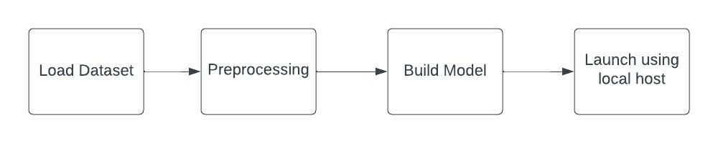
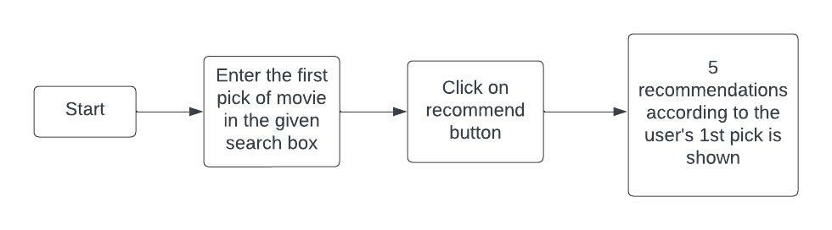
SYSTEM DESIGN
PHASE 1
As depicted in the figure, the project is divided in two phases.
Phase 1 deals with loading, preprocessing and building model. In this phase, the model that performs training on the data set the best, in other words, the model that provides highest accuracy, is saved onto the disk.
Phase 2 deals with loading the model that was saved in the previous phase, to test it by feeding a input by the user.
The user types a movie title into the search box and then selects the recommend option. The movie recommendation system then makes five recommendations depending on the user's input.
PHASE 2

Slide 9
IMPLEMENTATION
SAMPLE CODE
movies['tags'] = movies['overview'] + movies['genres'] + movies['keywords'] + movies['cast'] + movies['crew']
from sklearn.feature_extraction.text import CountVectorizer
cv = CountVectorizer(max_features=5000,stop_words='english’)
vector = cv.fit_transform(new['tags']).toarray()
from sklearn.metrics.pairwise import cosine_similarity
similarity = cosine_similarity(vector)
def recommend(movie):
index = new[new['title'] == movie].index[0]
distances = sorted(list(enumerate(similarity[index])),reverse=True,key = lambda x: x[1])
for i in distances[1:6]:
print(new.iloc[i[0]].title)
Movie_name = input()
recommend('Movie_name')

Slide 10
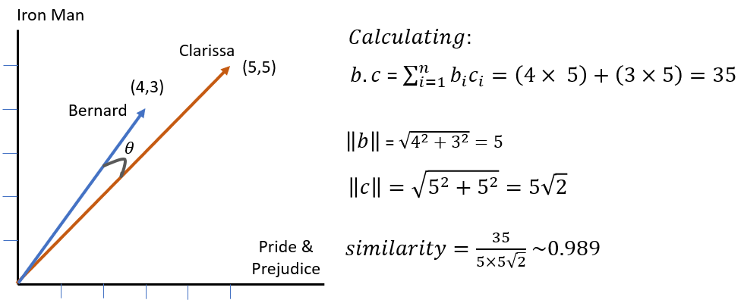
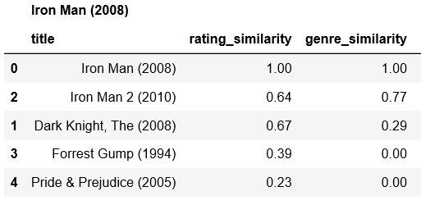
DETAILED DESIGN
(ii)Construct table consisting all the similarity values
(i)Calculating distances between two vectors

Slide 11
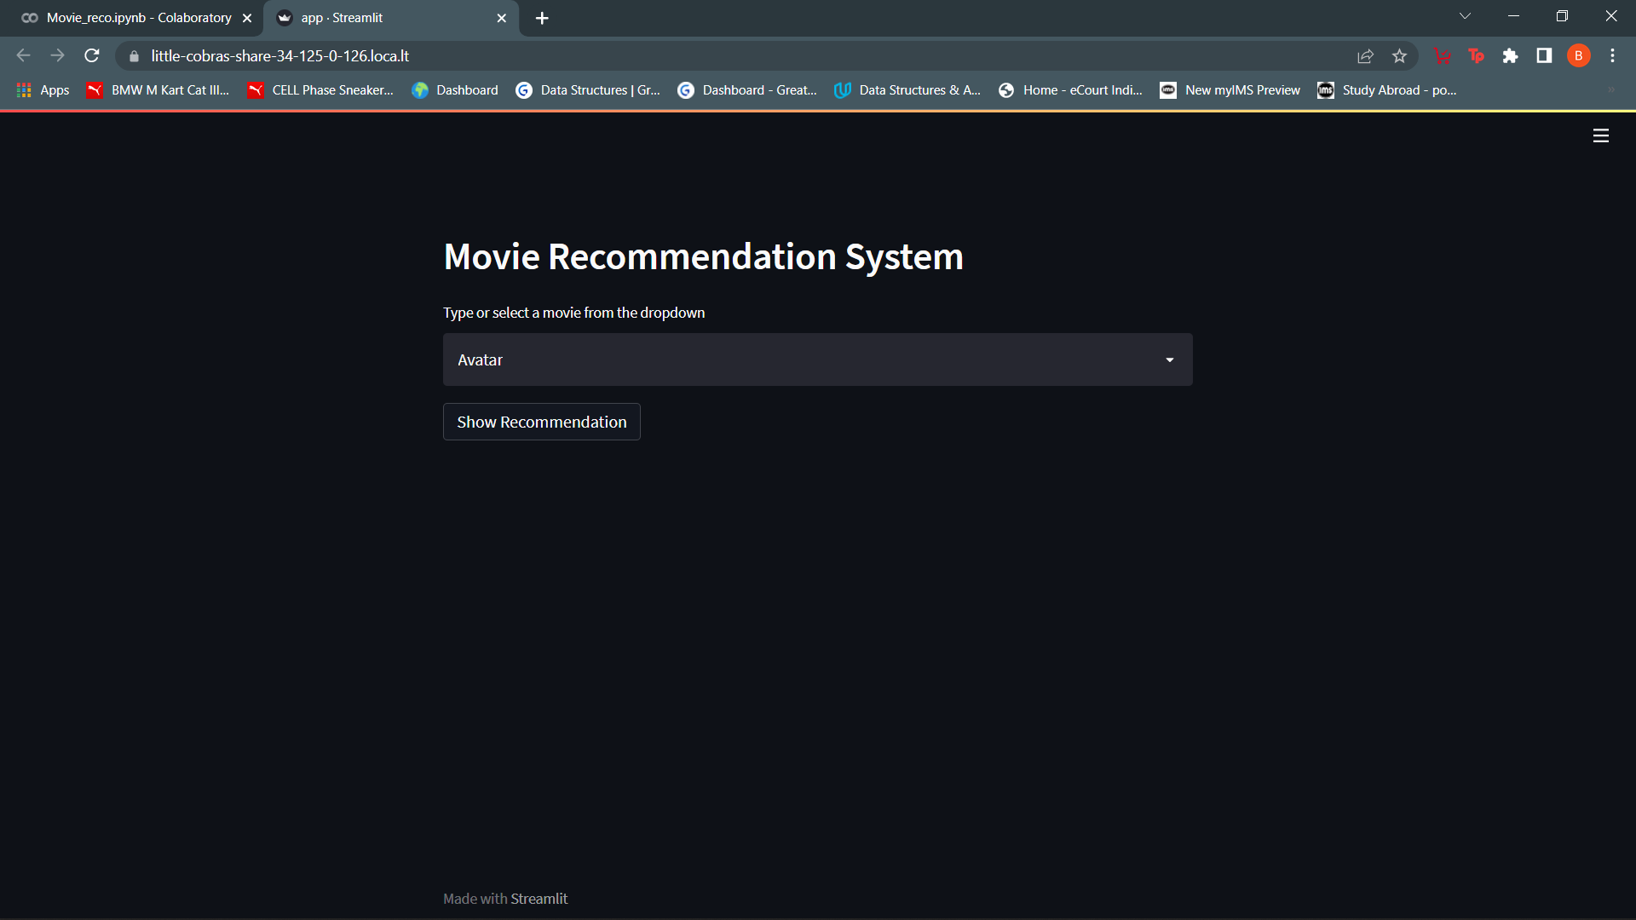
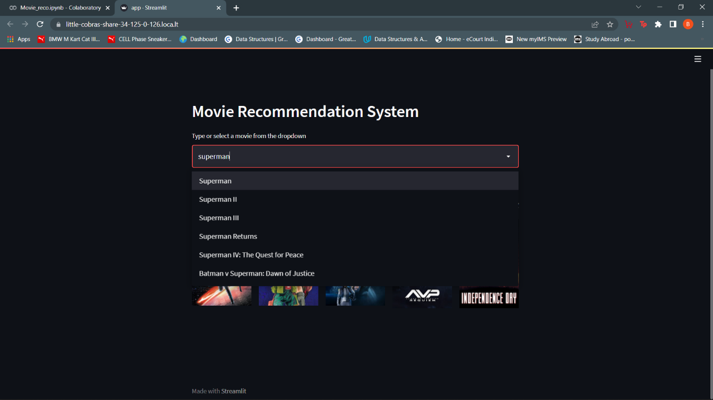
RESULTS

Slide 12
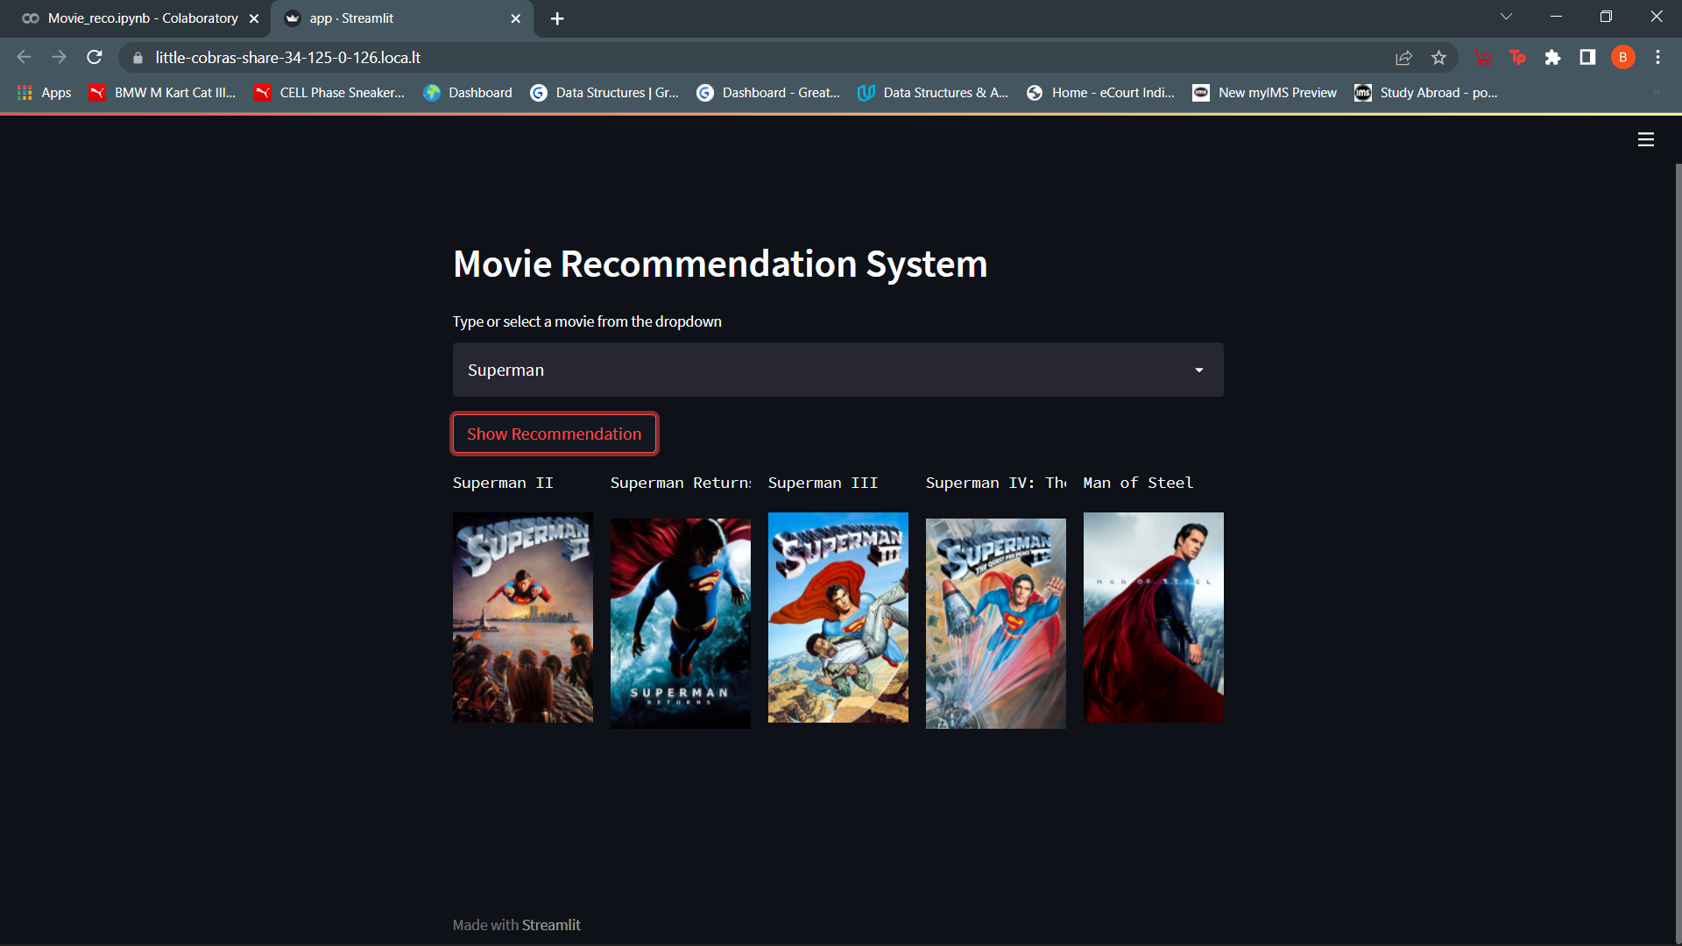
RESULTS

Slide 13
CONCLUSIONS
Recommender systems expand the scope of tailored information retrieval on the Internet.
It also helps to relieve the problem of information overload, which is a regular occurrence with information retrieval systems, by allowing users to access products and services that are not easily available to other users on the system.
We devise a technique that focuses on the user's personal preferences, and movies are recommended to him based on his prior reviews. This method aids in the improvement of recommendation accuracy.
In this project we have used numpy, pandas and requests module to implement the functioning of the code.
Movie Recommendation system recommends movies to the user out of a wide range of choices based on the user’s first choice.

Slide 14
LIMITATIONS
Since the feature representation of the items are hand-engineered to some extent, this technique requires a lot of domain knowledge. Therefore, the model can only be as good as the hand-engineered features.
The model can only make recommendations based on existing interests of the user. In other words, the model has limited ability to expand on the users' existing interests.

Slide 15
FUTURE ENHANCEMENTS
Any recommender system's accuracy can be improved by including more movie features.
The combination of collaborative filtering and content-based filtering has been demonstrated in the majority of articles.
The challenges associated with the two ways are attempted to be resolved by merging methods.
In any recommendation system, hybrid filtering is the most well-known strategy. Because doing so aids in the development of an effective recommendation system.
For content-based recommender system specifically, we attempt to find a new way to improve the accuracy of the representative of the movie

Slide 16
REFERENCES
[1] https://www.youtube.com/results?search_query=movie+recommendation+system+machine+learning+project
→ YouTube tutorials
[2] https://docs.streamlit.io/library/api-reference
→ Streamlit Documentation
[3] https://www.geeksforgeeks.org/python-implementation-of-movie-recommender-system/
→ Geeks for Geeks

Slide 17
THANK YOU

